Slide 1
Software Testing
Course Instructor
Sobia Usman

Slide 2
White box (structural) testing
White box testing concept requires verification of every program statement and comment
white box testing include
Data processing and calculations correctness tests
Software qualification tests
Maintainability tests
Reusability tests

Slide 3
White box (structural) testing
Software qualification, The focus here shifts to the examination of software code (including comments) compliance with coding standards and work instructions
Maintainability tests refer to special features, such as those installed for detection of causes of failure, module structures that support software adaptations and software improvements
Reusability tests examine the extent that reused software is incorporated in the package and the adaptations performed in order to make parts of the current software reusable for future software packages

Slide 4
Data processing and calculation correctness tests
To perform data processing and calculation correctness tests --“white box correctness test”
This type of verification allows us to decide whether the processing operations and their sequences were programmed correctly for the path in question
Raises the question of coverage of a vast number of possible processing paths and the multitudes of lines of code.

Slide 5
Data processing and calculation correctness tests
Two alternative approaches have emerged:
“Path coverage” – to plan our test to cover all the possible paths, where coverage is measured by percentage of paths covered.
“Line coverage” – to plan our tests to cover all the program code lines, where coverage is measured by percentage of lines covered.

Slide 6
Correctness tests and path coverage
Different paths in a software module are created by the choice in conditional statements, such as IF–THEN–ELSE or DO WHILE..
Path testing is motivated by the aspiration to achieve complete coverage of a program by testing all its possible paths.
Path test’s completeness is defined as the percentage of the program paths executed during the test.
It is impractical in most of the cases because of the vast resources required for its performance
Example: software module -10 conditional statements(allowing 2 options)

Slide 7
Correctness tests and line coverage
For full line coverage- every line of code be executed at least once during the process of testing.
The line coverage metrics for completeness of a line-testing (“basic path testing”) plan are defined as the percentage of lines indeed executed – that is, covered – during the tests.
Line Coverage- require fewer test cases but leave most of the possible paths
Flow chart and a program flow graph can be helpful
In a flow chart, diamonds present the options covered by conditional statements (decisions)
rectangles represent the software sections connecting those conditional statements.

Slide 8
Correctness tests and line coverage
In program flow graphs, nodes represent software sections and thus replace one or more flow chart rectangles.
The edges indicate the sequence of software sections.
Nodes having two or more leaving edges represent conditional statements

Slide 9
McCabe’s cyclomatic complexity metrics
Cyclomatic complexity is a software metric (measurement). It is used to indicate the complexity of a program.
It directly measures the number of linearly independent paths through a program's source code.
Cyclomatic complexity is computed using the control flow graph of the program
Called Basis Path Testing by McCabe who first proposed it

Slide 10
McCabe’s Cyclomatic Complexity metrics
The cyclomatic complexity of a section of source code is the count of the number of linearly independent paths through the source code.
if the source code contained no decision points such as IF statements or FOR loops, the complexity would be 1
Since there is only a single path through the code. If the code had a single IF statement containing a single condition there would be two paths through the code, one path where the IF statement is evaluated as TRUE and one path where the IF statement is evaluated as FALSE.

Slide 11
Example – the Imperial Taxi Services (ITS) taximeter
Imperial Taxi Services (ITS) serves one-time passengers and regular clients (identified by a taxi card). The ITS taxi fares for one-time passengers are calculated as follows:
(1) Minimal fare: $2. This fare covers the distance traveled up to 1000 yards and waiting time (stopping for traffic lights or traffic jams, etc.) of up to 3 minutes.
(2) For every additional 250 yards or part of it: 25 cents.
(3) For every additional 2 minutes of stopping or waiting or part thereof: 20 cents.
(4) One suitcase: no charge; each additional suitcase: $1.
(5) Night supplement: 25%, effective for journeys between 21.00 and 06.00.
Regular clients are entitled to a 10% discount and are not charged the night supplement.

Slide 12
Example – the Imperial Taxi Services (ITS) taximeter
When planning the basic path testing plan of the new taximeter module
prepare a flow chart and a program flow graph for the taxi fare calculation process
Each figure represents a calculation process that includes five decisions
full path coverage requires that all the possible paths be executed at least once

Slide 13
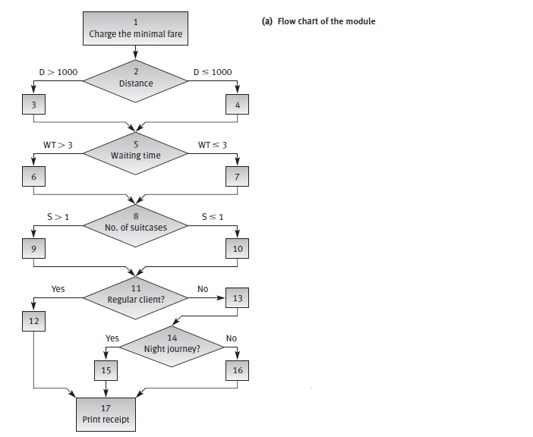
ITS flow chart

Slide 14
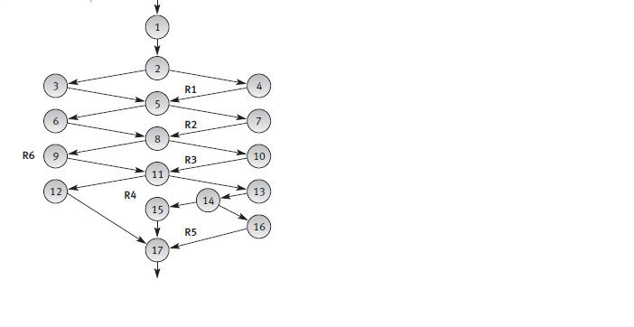
ITS :Program flow graph of the module

Slide 15
Example – the Imperial Taxi Services (ITS) taximeter
In the ITS flow chart, 24 different paths may be indicated., in order to achieve full path coverage of the software module we have to prepare at least 24 test cases
In contrast, the program flow graph allows us to observe that full line coverage of the ITS software module can be reached by inspecting the minimum number of paths – a total of three
The proportion of test cases required to test the system by full line coverage of three test cases (by basic path testing) versus full path coverage of 24 test cases is 1:8! This ratio grows rapidly with program complexity.

Slide 16
Exercise
Q1:Calculate the cyclomatic complexity of given example(the Imperial Taxi Services (ITS) taximeter) and specify which independent paths are needed to test this?

Slide 17
Solution
Formula: V(G) = E – N + 2
E = 21, N = 17
V(G) = E – N + 2 = 21 – 17 + 2 = 6
Path No | The Path
1 | 1-2-3-5-6-8-9-11-12-17
2 | 1-2-4-5-6-8-9-11-12-17
3 | 1-2-3-5-7-8-9-11-12-17
4 | 1-2-3-5-6-8-10-11-12-17
5 | 1-2-3-5-6-8-9-11-13-14-15-17
6 | 1-2-3-5-6-8-9-11-13-14-16-17

Slide 18
Advantages of White box Testing
Direct statement-by-statement checking of code enables determination of software correctness as expressed in the processing paths, including whether the algorithms were correctly defined and coded.
It allows performance of line coverage follow-up (applying specialized software packages) that provides the tester with lists of lines of code that have not yet been executed. The tester can then initiate test cases to cover these lines of code.
It ascertains quality of coding work and its adherence to coding standards.

Slide 19
Disadvantages of White box Testing
The vast resources utilized, much above those required for black box testing of the same software package.
The inability to test software performance in terms of availability (response time), reliability, load durability, and other testing classes related to operation, revision and transition factors.

